Slide 1

B.TECH MAJOR PROJECT · MIDTERM EVALUATION
Semantic Retrieval and Contextual Exploration System
Finding Pankatis of Sri Guru Granth Sahib that carry the same Bhavarth, even when they share no words
Balkaran Singh | 2302494
Gurpreet Kaur | 2302530
Gurveer Singh | 2302533
Department of Computer Science and Engineering
Guru Nanak Dev Engineering College, Ludhiana
October 2026
Under the guidance of Dr. Parminder Singh
Notes:
Introduce the team and guide. One sentence on the project: given one line of Gurbani, find other lines with the same meaning, even when no words are shared.

Slide 2
Two Pankatis, seven hundred Angs apart, teach the same thing in different words
INTRODUCTION
ANG 189
ANG 889
ਵਿਸਰੀ ਤਿਸੈ ਪਰਾਈ ਤਾਤਾ
ਛਾਡਿ ਵਿਡਾਣੀ ਤਾਤਿ ਮੂੜੇ
Envy of others is forgotten
Fool, give up envy of others
0 shared words
Same Bhavarth
Keyword search cannot connect these two lines, however it is tuned.
A system that understands meaning should place them next to each other.
Notes:
Read both lines. Point out that they share no word, yet both teach giving up envy. This is the core task: the system must connect lines like these.

Slide 3
Objectives
OBJECTIVES
Following are the objectives for the project work:
To develop a semantic representation framework for capturing the contextual meaning (Bhavarth) of Gurbani text.
1
To develop a semantic retrieval system for identifying and ranking Gurbani Pankatis based on contextual and thematic similarity.
2
To develop an intelligent Gurbani information system integrating semantic retrieval with Gurbani metadata, Raag information, and relevant digital resources.
3
Notes:
These are the three objectives exactly as stated in the report.

Slide 4
The project is feasible on four counts, and the first phase shows it
FEASIBILITY STUDY
Technical
FEASIBLE
Economic
FEASIBLE
Operational
FEASIBLE
Schedule
ON TRACK
BGE-M3 already supports Punjabi; no model is built from scratch
60,360 Pankatis with five Steeks each are already collected
LoRA trains about 0.4% of parameters, so training fits a 12 GB RTX 3060
FAISS searches 54,844 vectors in under a second
All software is open source: PyTorch, sentence-transformers, PEFT, FAISS
The base model is a free download
No paid API or cloud service
A student laptop and one consumer GPU; a training run takes about 10 minutes
Runs on an ordinary laptop: stored verses use cached vectors, so the model is never loaded
Accepts a verse without its danda, a partial verse, or a whole Shabad
Each result shows Ang, Raag and Steek, so readers can check the match
Phase 1 complete: clean data, benchmark, and a fine-tuned model that beats keyword search
Phase 2 builds on finished stages
Stages are independent scripts, each testable alone
Ethical: the system retrieves existing Gurbani and never generates scripture. Explanations come from the Steeks of named commentators.
Notes:
Technical: model and data already exist; LoRA makes training fit one GPU. Economic: everything is free and open source. Operational: search runs on a laptop. Schedule: phase 1 is done.

Slide 5
What existing work provides, and what it leaves open
LITERATURE SURVEY
WORK | CONTRIBUTION | GAP FOR GURBANI
Sentence-BERT Reimers & Gurevych, 2019 | Siamese networks trained with a contrastive objective | General-domain; the training recipe we adapt
Dense Passage Retrieval Karpukhin et al., 2020 | Dense vectors outperform BM25 for open-domain retrieval | Needs labelled pairs; none exist for Gurbani
LaBSE, Multilingual E5 Feng et al., 2022; Wang et al., 2024 | Multilingual sentence embeddings, 100+ languages | Modern web text, not archaic Gurmukhi
IndicNLPSuite, Samanantar, IndicSBERT 2020 – 2023 | Corpora and models for Indian languages incl. Punjabi | Contemporary Punjabi; no scripture
BGE-M3 Chen et al., 2024 | Multilingual model built for retrieval; our base model | Unadapted, it loses to BM25 on Gurbani
LoRA Hu et al., 2022 | Low-rank adapters for cheap fine-tuning | Makes training fit one GPU
BM25, FAISS Robertson 2009; Douze et al., 2024 | Keyword ranking; fast vector search | Our baseline and our index
Notes:
Dense retrieval and multilingual embeddings exist, but none cover archaic Gurmukhi, and dense retrieval normally needs labelled pairs that do not exist here.

Slide 6
The commentators already did the semantic work
METHODOLOGY · KEY INSIGHT
Meaning is hard to see in the verses and easy to see in the Steeks. Two Pankatis that mean the same thing are explained in nearly the same modern Punjabi.
 | TEXT | SHARED WORDS
Pankati A | ਵਿਸਰੀ ਤਿਸੈ ਪਰਾਈ ਤਾਤਾ | none
Pankati B | ਛਾਡਿ ਵਿਡਾਣੀ ਤਾਤਿ ਮੂੜੇ
Steek of A | ਉਸ ਨੂੰ ਹੋਰਨਾਂ ਨਾਲ ਈਰਖਾ ਕਰਨੀ ਭੁੱਲ ਜਾਂਦੀ ਹੈ | ਈਰਖਾ · ਕਰਨੀ · ਨਾਲ
Steek of B | ਹੇ ਮੂਰਖ! ਦੂਜਿਆਂ ਨਾਲ ਈਰਖਾ ਕਰਨੀ ਛੱਡ ਦੇ
A pair counts only when two independent commentators (Sahib Singh and Manmohan Singh) both explain the verses alike, and the verses come from different Shabads. The same rule mines training pairs from the train split and a gold benchmark from the test split.
Notes:
The verses share nothing, but their Steeks share three words. Word overlap on Steeks stands in for meaning on verses. We use this twice: for training pairs and for the gold benchmark.

Slide 7
From 60,360 rows to a clean, leakage-free corpus
METHODOLOGY · DATASET AND SPLIT
60,360
−5,077
55,217
54,844
rows in the source workbook, five Steeks each
structural and heading lines, flagged for audit, not deleted
trainable rows retained
unique Pankatis in the retrieval corpus
GROUPED SPLIT · union-find on same Shabad, identical Pankati, identical Steek
Train · 131,806 pairs
Val · 16,457
Test · 16,515
0
overlap on all 12 cross-partition checks (Pankati, Shabad, group, Steek), so the results measure learning, not leakage.
Notes:
The source flag caught only 720 of about 5,000 heading lines; our detector finds the rest. The split is grouped, not random: union-find joins rows sharing a Shabad, an identical Pankati or an identical Steek, so near-duplicates cannot straddle train and test.

Slide 8
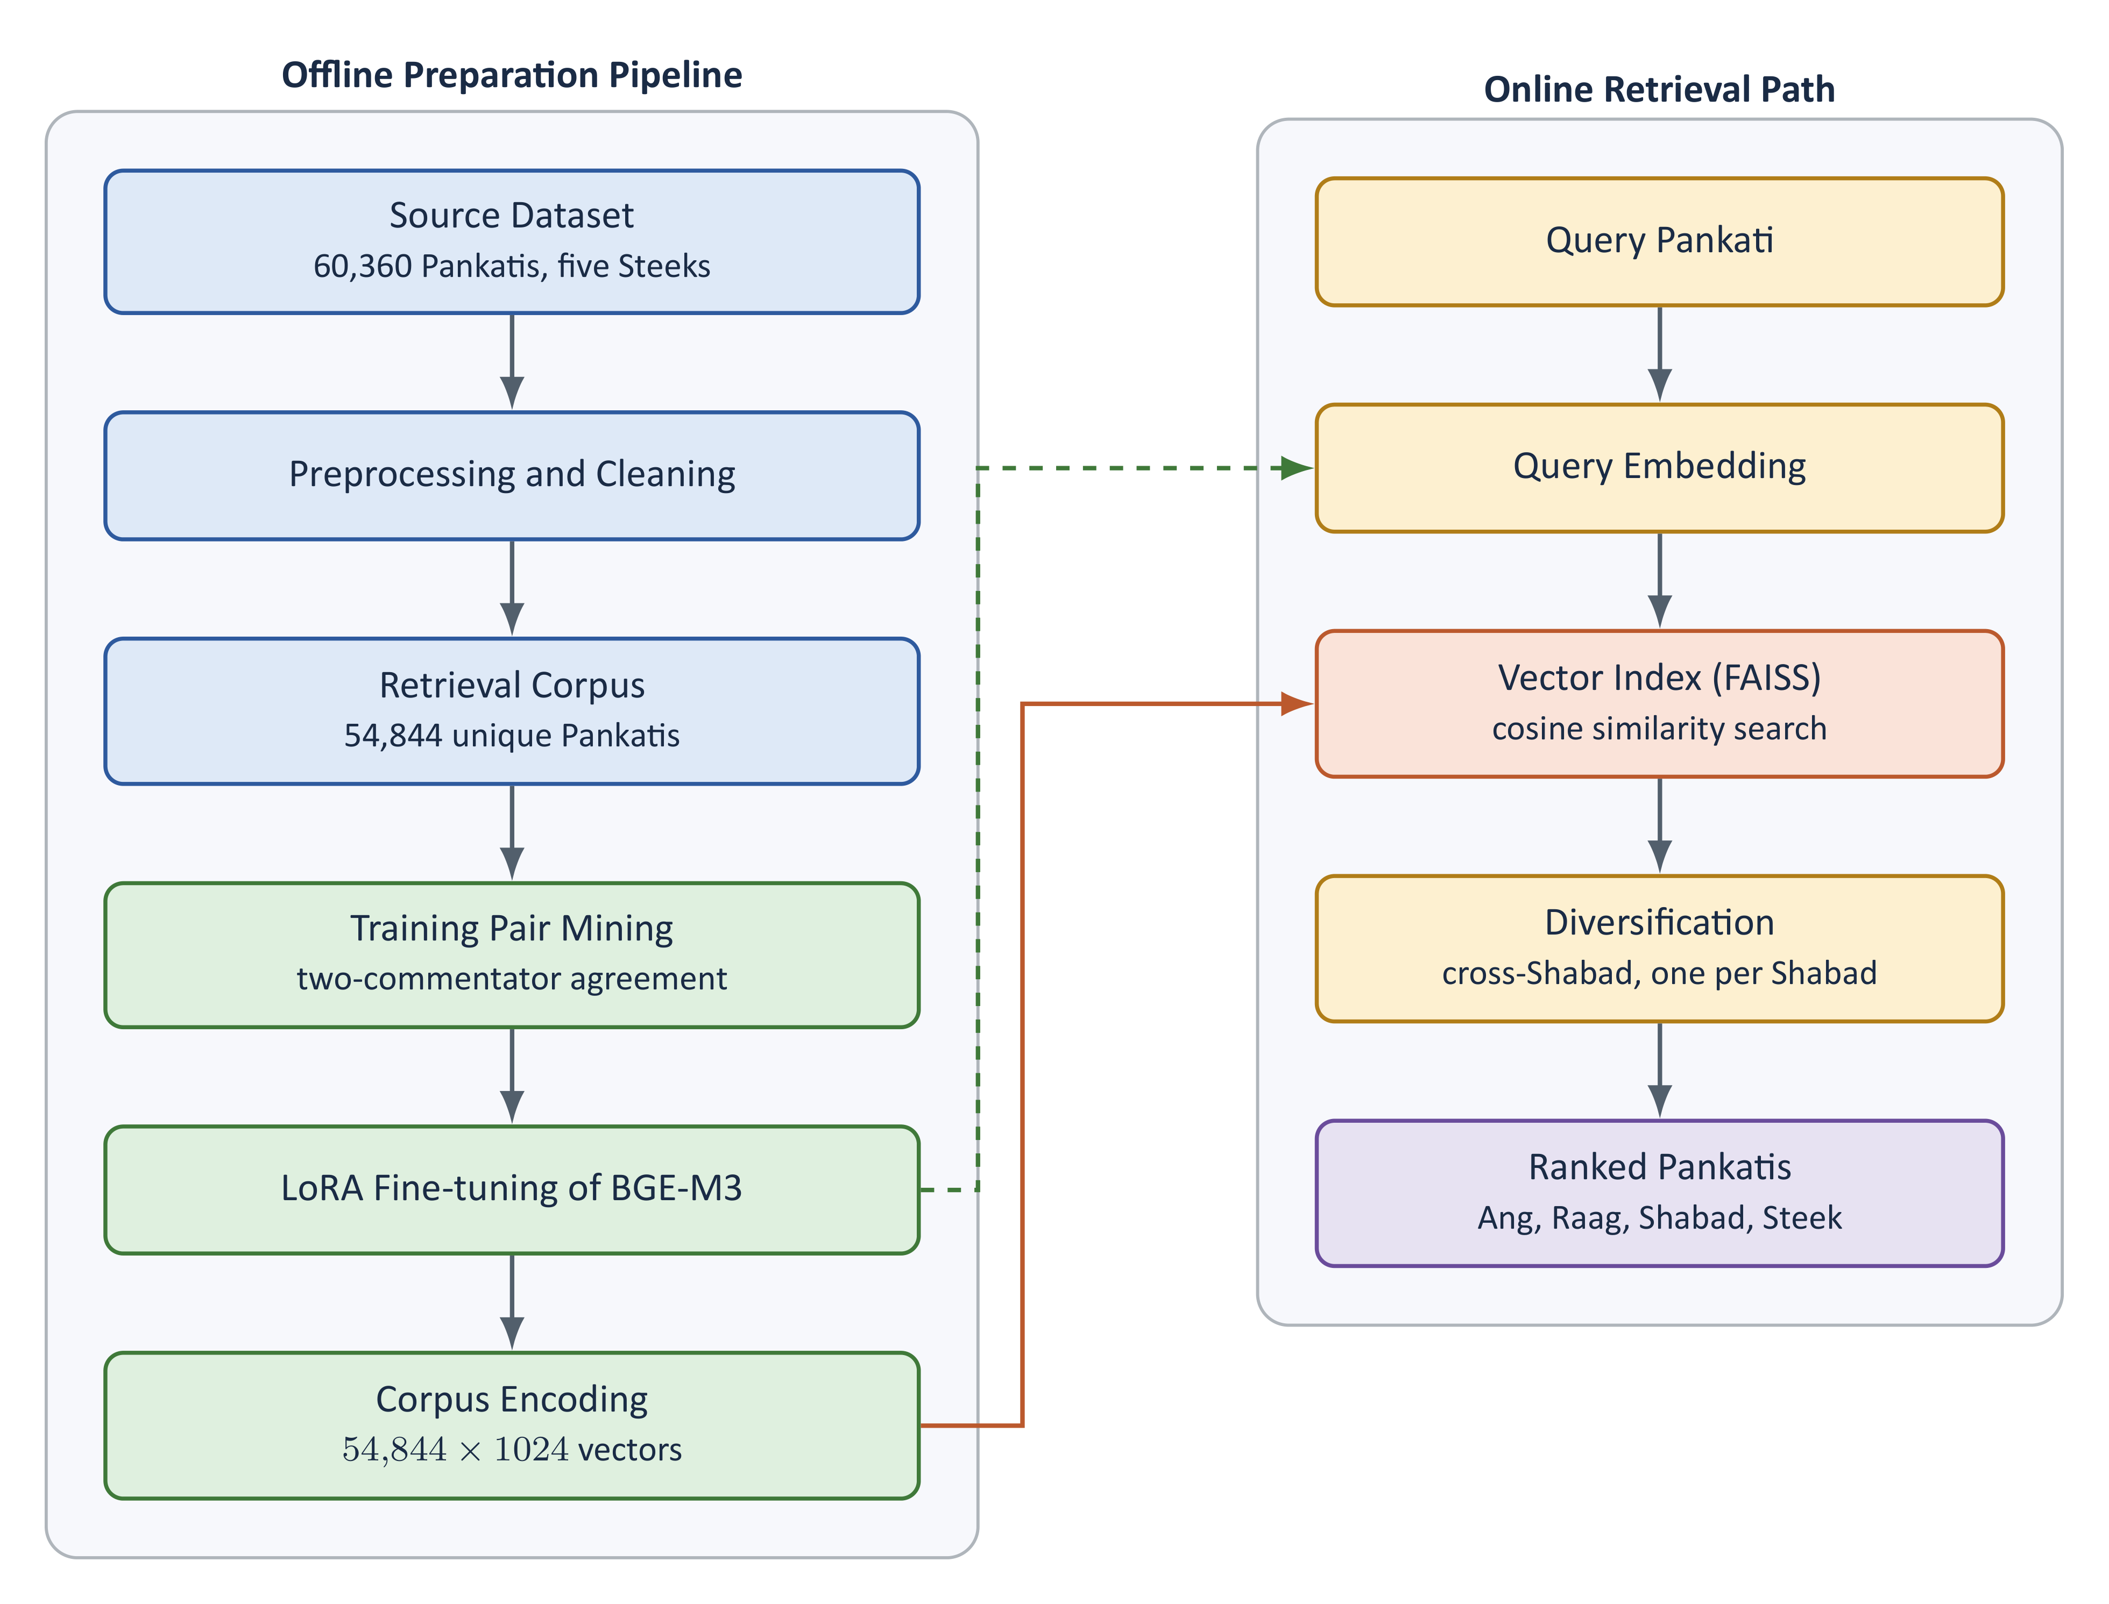
Offline preparation, online retrieval
SYSTEM DESIGN · ARCHITECTURE
Six independent stage scripts; each reads files and writes new ones, so any stage re-runs alone
Base model BGE-M3: 568M parameters, 24 layers, 1024-dimensional vectors, covers Punjabi
A query already in the corpus uses its cached vector; the model is never loaded and search takes under a second
Results exclude the query's own Shabad and keep at most one line per Shabad
Notes:
Left: offline pipeline, run once. Right: what happens per query. A query already in the corpus reads its cached vector, so search works on the laptop without loading the 2.3 GB model.

Slide 9
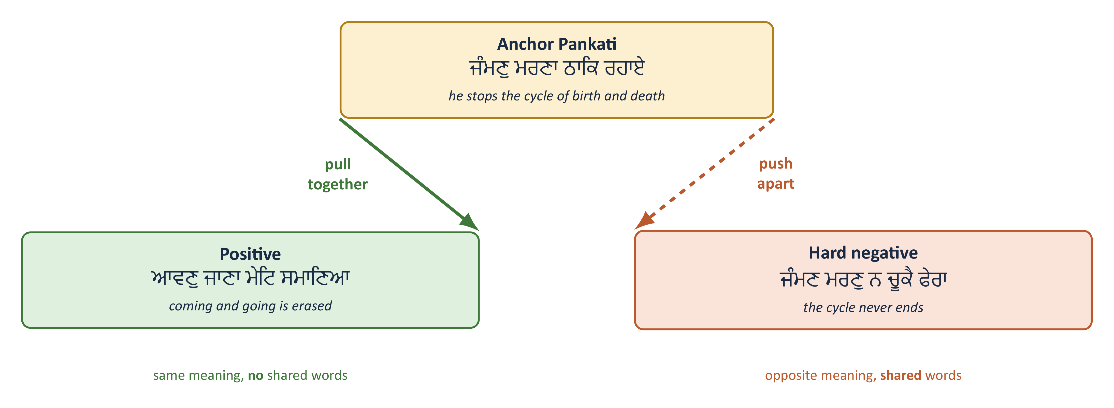
Contrastive fine-tuning with LoRA
METHODOLOGY · MODEL TRAINING
0.4%
of parameters trained: LoRA on query, key and value, rank 16; the adapter is about 5 MB
63
negatives per example at batch size 64; the other batch items act as negatives
~10 min
for 5 epochs on an RTX 3060; corpus encoding takes 3 min there vs 112 min on the laptop
Notes:
The model pulls the anchor toward its positive and pushes it from the hard negative, which shares words but means the opposite. Batch size matters: other batch items act as negatives.

Slide 10
Verse-pair tuning is the first system to beat keyword search
RESULTS · HIT@10 ON THE BENCHMARK
+8.92
points of Hit@10 over the pretrained model (19.37 → 28.29)
2.5×
the pretrained model on pairs sharing no word with the query (1.43 → 3.57)
Hit@10: share of queries with at least one gold Pankati in the top 10. Identical queries, same 54,844-line corpus, own Shabad excluded.
Notes:
Pretrained BGE-M3 is below both keyword baselines. Steek-pair tuning did not help. Verse-pair tuning is the only system above the best keyword baseline.

Slide 11
Three findings that set the direction of the project
RESULTS · FINDINGS
19.37 vs 27.09
38.0 → 61.6
+8.92
The pretrained model loses to keyword search
Training on the wrong task changes nothing
The right pairs beat more pairs
A state-of-the-art multilingual model, used as is, scores below character BM25. This justifies Gurbani-specific training rather than assuming it.
Pankati↔Steek tuning lifted Steek→Pankati Hit@10 sharply, yet Pankati→Pankati stayed flat (19.37 → 18.50). The model learned; the skill did not transfer.
A few thousand mined verse-to-verse pairs did what 131,806 Steek pairs could not. The objective had to change, not the amount of data.
Notes:
The diagnostic in the middle is the key: training worked on the task it was given, but that task was the wrong one. So we changed the objective, not the amount of data.

Slide 12
What phase one established, and what comes next
CONCLUSION AND FUTURE SCOPE
CONCLUSION
FUTURE SCOPE
Verse-to-verse supervision can be built without manual labels, from agreement between two independent commentators
A pretrained multilingual model is not enough: unadapted BGE-M3 scores below keyword search
The objective matters more than data volume: verse-pair tuning reached 28.29 Hit@10 and 16.77 MRR, best on every measure
Verses sharing no word improved 2.5× but remain the hardest case
NEXT Hard-negative training
Train on the 5,343 mined triplets so that opposite teachings separate
THEN Reranker and explanations
Rerank with bge-reranker-v2-m3; an LLM layer explains each match from its Steeks
FINALLY Web interface
A FastAPI service and web front end replace the command line
Notes:
Conclusion: labels without manual work; the pretrained model is not enough; the objective matters more than data volume. Caveat to state if asked: the benchmark is mined from Steeks, so measured recall is a lower bound and the benchmark is not fully independent of training; BM25 is scored on the same set, so comparisons stay fair. Next: hard-negative training, reranker plus LLM explanations, then a web interface.

Slide 13
THANK YOU
Balkaran Singh · Gurpreet Kaur · Gurveer Singh | Guide: Dr. Parminder Singh
Notes:
Invite questions. Likely ones: why the benchmark is trustworthy (grouped split, same set for all systems), why the pretrained model lost, what hard negatives will change.

